Slide 1

CPE 640 AI Project Topic: Life Loss Alert During Flooding Due To Dam Breaks Domain: Bayesian Network
Mr. Nadir Hussain Master in Computer Engineering)

Slide 2
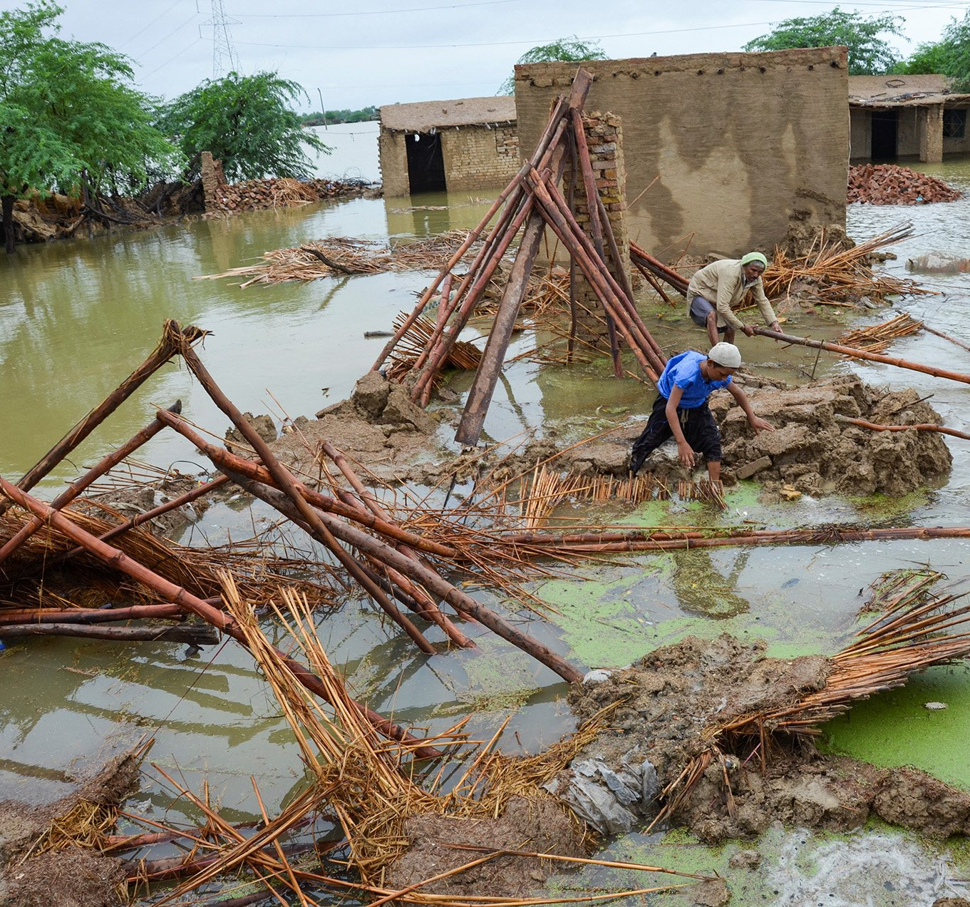

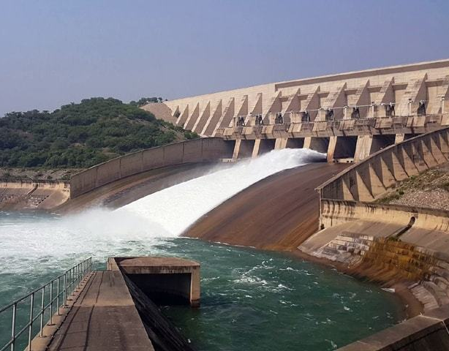
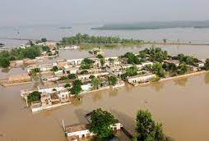
Context of Project: The scenario involves a small village located near a water dam. There's a risk of dam failure due to flooding, necessitating an early warning system to evacuate residents to safety.
Notes: The above images are from the Pakistan flood, sourced from various news channels.

Slide 3

Introduction to Netica Software What is Netica? Netica is a powerful software tool used for probabilistic reasoning and Bayesian network modeling. It enables users to build, analyze, and visualize probabilistic models efficiently.

Slide 4
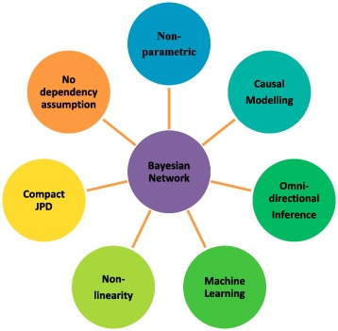
What is a Bayesian Network? A Bayesian network is a graphical model representing probabilistic relationships among a set of variables. It uses directed acyclic graphs (DAGs) to depict dependencies between variables. Nodes represent variables, while edges represent probabilistic dependencies.

Slide 5
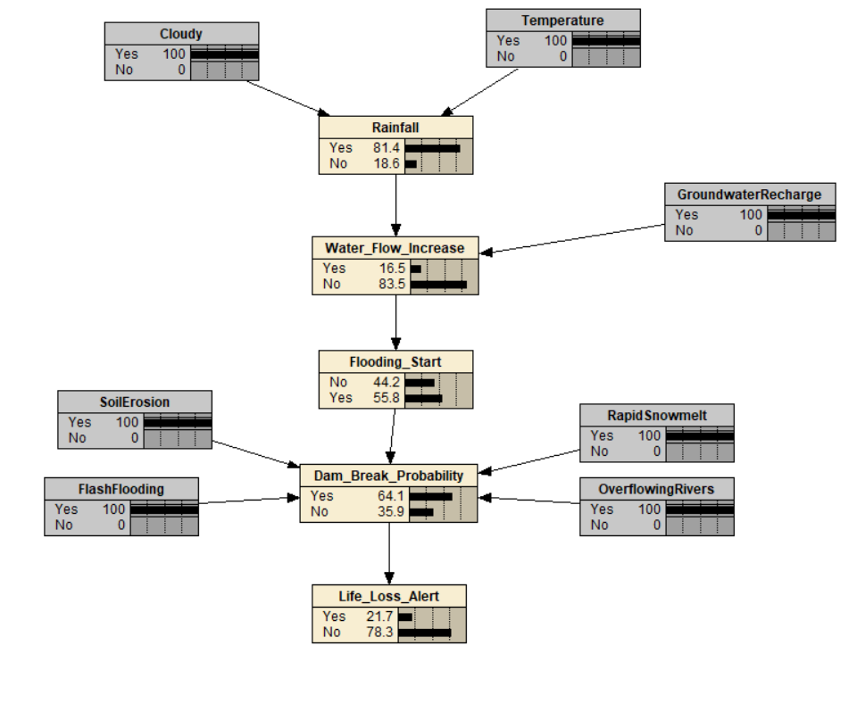
Nodes in the Bayesian Network Cloudy Temperature Rainfall Water Flow Increase Flooding Start Soil Erosion Flash Flooding Rapid Snowmelt Overflowing Rivers Dam Break Probability Life Loss Alert

Slide 6

Working of the Bayesian Network Probabilistic Inference: The Bayesian network uses probabilistic inference to calculate the likelihood of events occurring based on the evidence provided. It updates beliefs in real-time as new evidence becomes available. Decision Support: The network provides decision support by evaluating the risk of dam break and triggering life loss alerts accordingly. Scenario Simulation: Users can simulate different scenarios by manipulating evidence values to assess potential outcomes and plan appropriate responses.

Slide 7

Conclusion Netica Software and Bayesian Network for Risk Management: Netica offers a robust platform for building Bayesian networks to model complex systems and mitigate risks effectively. The Bayesian network for the scenario "Dams Broke Due to Flooding Property Loss" demonstrates the practical application of probabilistic modeling for disaster preparedness and response.

Slide 8

Thanks, You Everyone for your Precious time

